Slide 1
What's new in SLE
Dr. Husham AlDaoseri

Slide 2
Systemic lupus erythematosus (SLE) is a chronic autoimmune disease affecting different organs and systems. Despite the etiology of the disease is not fully clarified, a multifactorial pathogenesisis largely accepted with genetic, environmental , and hormonal factors contributing to its development . The production of several autoantibodies , associated with different clinical pheno- types, could be considered a disease hallmark . The SLE course is variable ,mainly characterized by remission and relapse periods.

Slide 3
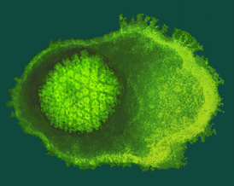
SLE - Etiology
The etiology of SLE remains unknown
Yet, SLE is clearly multifactorial:
Genetic factors
Immunologic factors
Hormonal factors
Environmental factors
EBV?
Genetic predisposition
Baseline immunological abnormalities
Infection
Hormonal factors
Abnormal (control of) immune responses
SLE

Slide 4
Immunogenetics
Increased Risk for SLE in:
HLA-DR2 (anti-DNA Abs)
HLA-DR3 (anti-Ro Abs)
Null alleles at C2 and C4 loci
SLE may be transmitted in an autosomal dominant pattern (family studies)

Slide 5
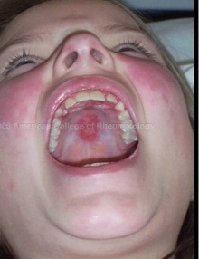
ACR Criteria for Lupus Diagnosis
SKIN
GI
MUSCULO-SKELETAL
PULMONARY /CARDIAC
RENAL
NEUROLOGICAL
HEMATOLOGIC
IMMUNOLOGIC
Malar Rash
Discoid Rash
Photo-sensitivity Rash
Oral Ulcers
NonerosiveArthritis
Pleurisy
Pericarditis
Renal Disorder
(Lupus Nephritis)
Seizures or Psychosis
Leuko-penia
Hemolytic
anemia
Thrombo-cytopenia
Anti- nuclear Antibody (ANA)
dsDNA
APL anti.
Anti. Sm
Four at any time ⇒ possible SLE DIAGNOSIS

Slide 6
New SLICC* Revision of the ACR Classification Criteria - Clinical
1. Acute/subacute cutaneous lupus
2. Chronic cutaneous lupus
3. Oral/Nasal ulcers
4. Nonscarring alopecia
5. Inflammatory synovitis with physician-observed swelling of two or more
joints OR tender joints with morning stiffness
6. Serositis
7. Renal: Urine protein/creatinine (or 24 hr urine protein) representing at
least 500 mg of protein/24 hours or red blood cell casts
8. Neurologic: seizures, psychosis, mononeuritis multiplex, myelitis, peripheral or cranial neuropathy, cerebritis (acute confusional state)
9. Hemolytic anemia
10. Leukopenia (< 4000/mm3 at least once) OR Lymphopenia (< 1000/mm3 at least once)
11. Thrombocytopenia (<100,000/mm3) at least once
*Systemic Lupus International Collaborating Clinics (SLICC)

Slide 7
SLICC Revision of the ACR Classification Criteria – Immunologic
1. ANA (antinuclear antibody) above laboratory reference range
2. Anti-dsDNA above laboratory reference range (except ELISA: twice above laboratory reference range)
3. Anti-Sm (anti-Smith) antibody
4. APS abs: LAC, false-positive test for syphilis, anticardiolipin IgG, IgM, or IgA Abs, at least twice normal or medium-high titer, same for anti-B2 glycoprotein 1
5. Low complement: low C3, low C4, low CH50
6. Direct Coombs test in the absence of hemolytic anemia

Slide 8
2012-SLICC* classification criteria
At least 1 clinical + at least 1 immunologic
Criteria ( for a total of 4)
OR
Lupus Nephritis by biopsy
with ANA or anti-dsDNA antibodies

Slide 10
Clinical Domain and Criteria Weight
2 Fever>38.3ºc
Cutaneous domain
Non-scarring alopecia 2 Oral ulcer 2 Subacute cutaneous or discoid 4 Acute cutaneous 6
Arthritis domain
Synovitis in ≥ 2 joints or 6 tenderness in ≥2 and ≥ 30 minutes of morning stiffness
Neurological domain
Delirium 2 Psychosis 3 Seizeure 5
Serositis domain
Pleural or Pericardial effusion 5 Acute Pericarditis 6
Hematological domin
Leucopenia 3 Thrombocytopenia 4 Autoimmune hemolysis 4
Renal domain
Proteinurria> 0.5g/ 24 h 4 Renal biopsy with class II orV 8 Lupus nephritis Renal biopsy with class III or IV 10 Lupus nephritis

Slide 11
Immunological Domain and Criteria
Antiphospholipid antibodies Domain
Anticardiolipin IgG> 40 GPL unit 2 Or Anti- B2gp1 IgG> 40 GPL unit Or lupus anticoagulant postive
Complement protein Domain
Low C3 or C4 3 Low C3 and low C4 4 at same time
Highly specific antibodies domain
Anti-dsDNA antibody 6 Anti-Smith antibody 6

Slide 12
DISEASE ACTIVITY MEASURES
British Isles Lupus Assessment Group (BILAG)
Systemic Lupus Activity Measure (SLAM)
SLE Disease Activity Index (SLEDAI)
Safety of Estrogen in Lupus Erythematosus National Assessment (SELENA) SLEDAI

Slide 13
SLEDAI
SLEDAI Score | Yes | No | Descriptor | Definition
8 | 1 | 0 | Seizure | Recent onset. Exclude metabolic, infectious, or drug causes.
8 | 1 | 0 | Psychosis | Altered ability to function in normal activity. Include hallucinations, incoherence , marked loose associations, marked illogical thinking, bizarre, disorganized, or catatonic behavior.
8 | 1 | 0 | Organic brain syndrome | Altered mental function with impaired orientation, memory, or other intellectual function, rapid onset and fluctuating clinical features
8 | 1 | 0 | Visual disturbance | Retinal changes of SLE. Include cytoid bodies, retinal hemorrhages, serous exudate or hemorrhages in the choroid, or optic neuritis.
8 | 1 | 0 | Cranial nerve disorder | New onset of sensory or motor neuropathy involving cranial nerves.
8 | 1 | 0 | Lupus headache | Severe, persistent headache; may be migrainous, but must nonresponsive to narcotic analgesia.
8 | 1 | 0 | CVA | New onset of cerebrovascular accident(s). Exclude arteriosclerosis.
8 | 1 | 0 | Vasculitis | Ulceration, gangrene, tender finger nodules, periungual infarction, splinter hemorrhages, or biopsy or angiogram proof of vasculitis.

Slide 14
SLEDAI Score | Yes | No | Descriptor | Definition
4 | 1 | 0 | Arthritis | More than 2 joints with pain and signs of inflammation
4 | 1 | 0 | Myositis | Proximal muscle aching/weakness, associated with elevated CPK/ aldolase /EMG changes /biopsy showing myositis
4 | 1 | 0 | Urinary casts | Heme‑granular or red blood cell casts
4 | 1 | 0 | Hematuria | >5 red blood cells/high power field. Exclude stone, infection, others
4 | 1 | 0 | Proteinuria | >0.5 gm/24 hours.
4 | 1 | 0 | Pyuria | > 5 white blood cells/high power field. Exclude infection.
2 | 1 | 0 | Rash | Inflammatory type rash.
2 | 1 | 0 | Alopecia | Abnormal, patchy or diffuse loss of hair.
2 | 1 | 0 | Mucosal ulcers | Oral or nasal ulcerations
2 | 1 | 0 | Pleurisy | Pleuritic chest pain with pleural rub or effusion, or pleural thickening.
2 | 1 | 0 | Pericarditis | Pericardial pain with at least 1 of the following: rub, effusion, or +ECG or echo
2 | 1 | 0 | Low complement | Decrease in CH50. C3. or C4 below the lower limit of normal for testing laboratory.
2 | 1 | 0 | Increased DNA binding | Increased DNA binding above normal range for testing laboratory.
1 | 1 | 0 | Fever | >38°C. Exclude infectious cause.
1 | 1 | 0 | Thrombocytopenia | < 100x10⁹ platelets/L. Exclude drug causes
1 | 1 | 0 | Leukopenia | < 3x10⁹ WBC/L. Exclude drug causes

Slide 15
SLEDAI
Evaluates 24 lupus manifestations
Parameters are scored √ if present
Manifestation items are weighted with scores ranging from 1 to 8
Scores are totaled
Mild: 0-5
Moderate: 6-12
Severe: 13-20

Slide 16
SLICC/ACR damage Index
Item | Score
Ocular Any cataract ever Retinal change or optic atrophy | 0,1 0,1
Neuropsychiatric Cognitive impairment/ major psychosis Seizures requiring therapy for 6 months CVA ever (score 2 if >1) Cranial or peripheral neuropathy Transverse myelitis | 0,1 0,1 0,1 0,1 0,1
Renal Estimated GFR <50% Proteinuria >3.5 gm/24 h ESRD | 0,1 0,1 3
Pulmonary Pulmonary hypertension Pulmonary fibrosis and radiograph) Shrinking lung (radiograph) Pleural fibrosis (radiograph) Pulmonary infarction (radiograph) | 0,1 0,1 0,1 0,1 0,1
Cardiovascular Angina or coronary artery bypass Myocardial infarction ever (score 2 if > 1) Cardiomyopathy (ventricular dysfunction) Valvular disease (murmur >3/6) Pericarditis for 6 months, or pericardiectomy | 0,1 0,1,2 0,1 0,1 0,1
Item | Score
Peripheral vascular Claudication for 6 months Minor tissue loss (pulp space) Significant tissue loss ever ( loss of digit) (score 2 if >1 site) Venous thrombosis, swelling, ulceration, or venous stasis | 0,1 0,1,2 0,1 0,1
Gastrointestinal Infarction or resection of bowel below duodenum spleen, liver, or gall bladder ever, for cause any (score 2 if > 1 site) Mesenteric insufficiency Chronic peritonitis Stricture or upper gastrointestinal tract surgery ever | 0,1 0,1,2 0,1 0,1
Musculoskeletal Muscle atrophy or weakness Deforming or erosive arthritis Osteoporosis with fracture or vertebral collapse Avascular necrosis (score 2 if >1) Osteomyelitis Tendon Rupture | 0,1 0,1 0,1 0,1,2 0,1 0,1
Skin Scarring chronic alopecia Extensive scarring other than scalp and pulp space Skin ulceration (excluding thrombosis) for >6 months | 0,1 0,1 0,1
Premature gonadal failure | 0,1
Diabetes (regardless of treatment) | 0,1
Malignancy (exclude dysplasia) (score 2 if > 1 site) | 0,1,2

Slide 18
Despite improvements in survival, outcomes of contemporary treatment of systemic lupus erythematosus (SLE) are unacceptable.
Unlike in many diseases, treat-to-target (T2T) approaches have not been adopted in SLE, owing to a lack of validated targets to treat towards.
it is a key goal to validate target state definitions such as low disease activity and remission.

Slide 19
Definition of lupus low disease activity state (LLDAS)
SLEDAI-2k ≤4, excluding any major organ domains in the SLEDAI or haemolysis and gastrointestinal involvement (which are not included in the SLEDAI).
No new disease activity (on the basis that new disease activity may portend a flare)
Physician global assessment (PGA)≤ 1 (1-3) .
Treatment was captured in two further domains, requiring a prednisolone (or equivalent) dose of 7.5 mg/day and absence of toxic effects of current immunosuppressive treatment.
:

Slide 20
The Definition of Remission in SLE
SLEDAI (clinical) = 0 and PGA <0.5 on a scale of( 0-3).
also included consideration of classifying remission on therapy including antimalarials, low-dose glucocorticoids, immunosuppressives and biologics, as well as remission off therapy where only antimalarials were allowed
This means absent disease activity in clinical and organ-based laboratory tests, not including (that is, ignoring) anti-dsDNA antibodies and serum complement.
Definitions modified to include ‘complete’ remission, which also required absent anti-dsDNA antibodies and normal serum complement,

Slide 21
Treatment of SLE
Vitamin D (an immunomodulator!)
Hydroxychloroquine (HCQ) (Plaquenil®)
Corticosteroids – Minimize to the extent possible
Immunosuppressive agents (MTX, azathioprine, mycophenolate mofetil, etc)
Targeted biologic therapies: belimumab (Benlysta®), rituximab (Rituxan®)
Statins? especially for APS (antiphospholipid syndrome)?*

Slide 22
Every patient with lupus should be on vitamin D and hydroxychloroquine (HCQ)!
A 20-ng/ml increase in the 25 (OH) D level was associated with a 21% decrease in the odds of having a high disease activity score
Fifteen (15%) decrease in the odds of having clinically important proteinuria
There was no evidence of additional benefit of 25 (OH) D beyond a level of 40 ng/ml

Slide 23
Hydroxychloroquine (HCQ)
It prevents thrombotic events in lupus patients. Ongoing randomized multi-center trial, APS-ACTION, including UTMB
HCQ is an anti-platelet agent, inhibiting aPL-induced GPIIb/IIIa expression; it does not prolong bleeding time
It prevents lupus flare-ups and progression of disease, including lupus nephritis (LUMINA). It prevents diabetes in patients with RA receiving it
It lowers glycemia and lipids (although modestly)
It downregulates inflammation at different levels: prostaglandins, DNA Abs, T cell activation, inhibits intracellular TLR activation (7 & 9), inhibits IFN-a, IL-1 and IL-6 production, protects the annexin-5 anticoagulant shield from aCL, etc

Slide 24
Hydroxychloroquine in Lupus Pregnancy
No HCQ exposure during pregnancy (N=163)
Continuous use of HCQ during pregnancy (N=56)
Cessation of HCQ treatment either in the 3 months prior to or during the first trimester of pregnancy (N=38)
Results
No difference in congenital abnormalities, stillborns miscarriages
Higher incidence of Lupus Activity and Flare in Non-users
Clowse, M et al A & R 2006:54; 3640-3647

Slide 27
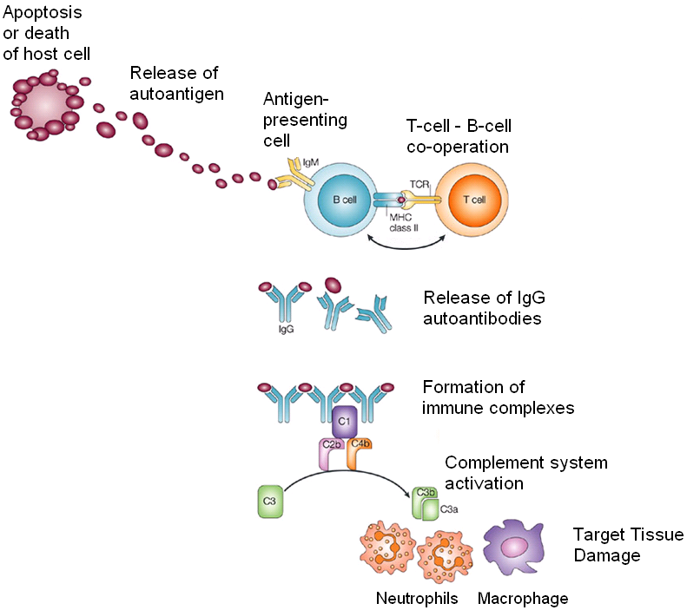
Targets for Emerging Therapies
Immune
Dysfunction
Defective
Regulatory
Circuits
Genetic susceptibility
Gender
Environmental factors
UV light
Infection
Defective
Immune
Complex
Clearance

Slide 28
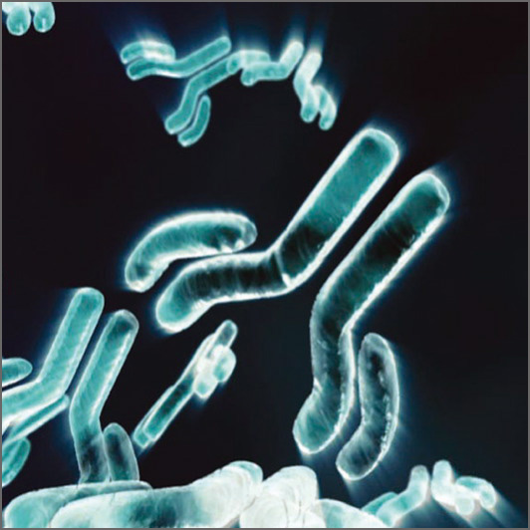
B-cell Depletion Therapies
Rituximab (anti-CD 20)
CD20: B cell surface marker for maturing B cells except for plasma and early precursor cells
- Chimeric monoclonal antibody against CD20
- Mechanism of action:
Induce apoptosis
Complement mediated cytolysis
Cell-mediated cytotoxicity

Slide 29
A Study to Evaluate the Efficacy and Safety of Rituximab in Subjects With Class III or IV Lupus Nephritis (LUNAR)
Phase III randomized, double-blind, placebo-controlled, multi-center study
144 patients with Class III or IV lupus nephritis from 60 sites in the U.S., Canada, Mexico, Argentina and Brazil.
Participants were treated with MMF and steroid and were randomized 1:1 to receive Rituxan or placebo in two infusions, 15 days apart.
The 1ry outcome: the proportion of patients who achieved a complete or partial remission after 52 weeks of treatment
No difference between the two arms

Slide 30
A Study to Evaluate the Efficacy and Safety of Rituximab in Patients With Severe Systemic Lupus Erythematosus (EXPLORER)
Phase II/III, RCT, multicenter study in USA
Aim: to evaluate the efficacy and safety of rituximab compared with placebo when combined with a single stable background immunosuppressive medication in subjects with moderate to severe SLE.
The primary efficacy endpoint of the trial were evaluated at 52 weeks.
The study enrolled approximately 257 subjects

Slide 31
A Study to Evaluate the Efficacy and Safety of Rituximab in Patients With Severe Systemic Lupus Erythematosus (EXPLORER)
Primary Outcome Measures: Clinical response based on the monthly assessments using the BILAG instrument
No difference between the two arms

Slide 32
B-cell Depletion Therapies
Rituximab in SLE
Open label, uncontrolled studies/case series
Favorable outcomes in range of refractory disease: nephritis, CNS disease, vasculitis

Slide 34
Ocrelizumab
a recombinant humanised monoclonal anti-CD20 antibody has been studied in Phase III trials in extrarenal SLE (BEGIN study) and lupus nephritis (BELONG study)
Further new monoclonal antibodies targeting CD20 have been developed which are fully humanized (Ofatumumab and90% humanized (Veltumumab).

Slide 35
Epratuzumab
– Humanized monoclonal Ab against CD22
– CD22 also B-cell surface marker
– Temporary reduction in B-cells
– Phase II studies small, open label: modest improvement
– ezpratuzumab is non depleting.
CD22 is expressed on pro-B-cells, pre-B-cells, and mature B-cells, and unlike CD20, delivers and modifies intracellular signalling.

Slide 36
B-cell survival Therapies
B-lymphocyte stimulator protein (BlyS) or(BAFF)
– Soluble protein within family of tumor necrosis factor
– Binds to surface receptors of activated B cells
B-cell proliferation and survival
B-cell differentiation into plasma cells
Higher levels (seen in active SLE patients) may contribute to autoantibody generation
Examples:
Atacicept: soluable rceptor fusion protein of TACI-IgG (Transmembrane activator & cyclophilin ligand interactor )
Belimumab: human monoclonal Ab against BlyS

Slide 37
B-cell survival Therapies
Belimumab:
human monoclonal Ab against Blys
Phase II RCT: drug & standard of care vs. placebo & standard of care—patients with measurable DNA or ANA levels responded by standardized scores, lower anti-dsDNA, and reduction in immunoglobulins

Slide 38
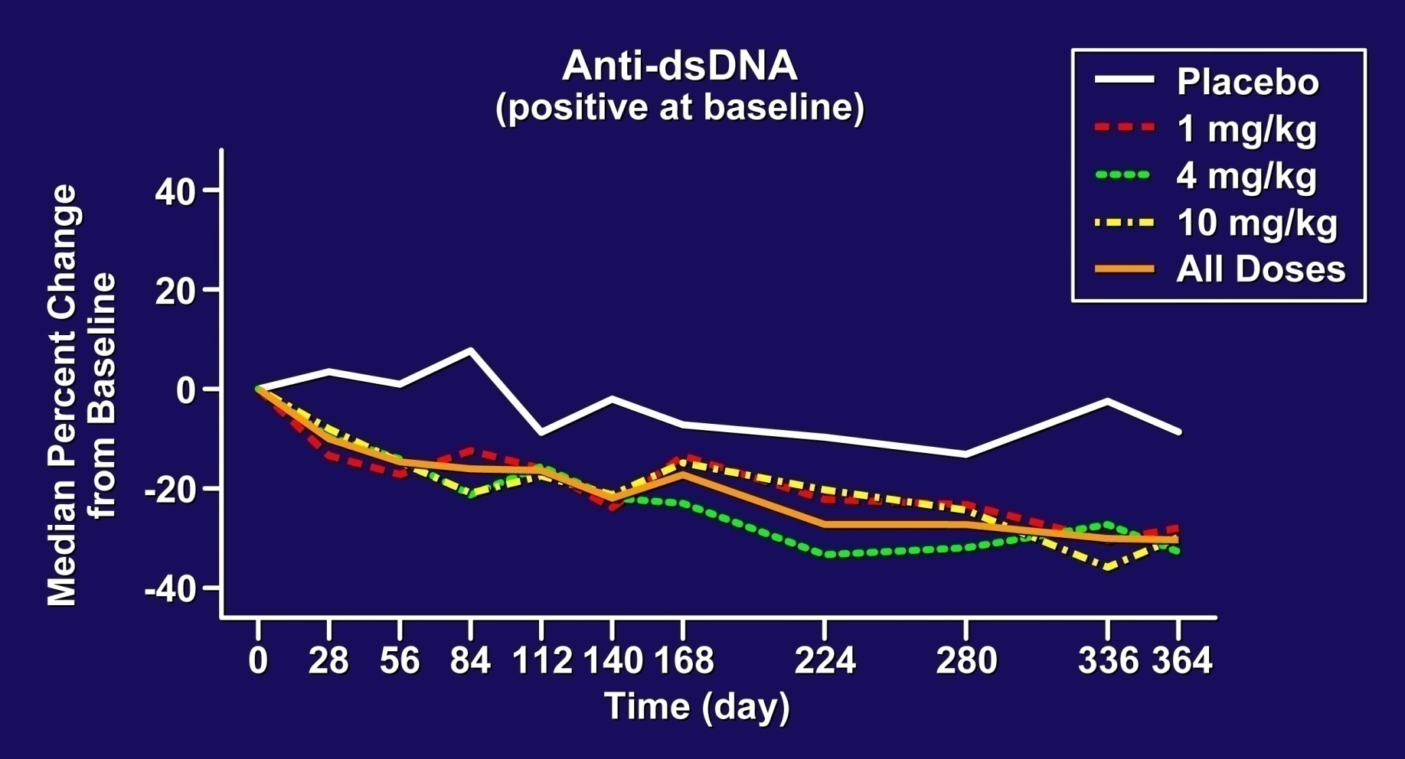
Belimumab Significantly Reduced Anti-dsDNA By Week 4
15% of anti-dsDNA positive subjects treated with belimumab converted to negative compared to 3% of placebo patients
Notes:
38

Slide 39
New FDA-Approved Agent – Belimumab (Benlysta®)
Anti-BLYS humanized monoclonal antibody. Ongoing Phase IV trials in African-American patients (multi-center trial including UTMB)
Problematic indications: not for thrombocytopenia, CNS, or renal lupus
Helpful but modest efficacy
It helps reduce steroids, prevent flares, and maintain disease remission!

Slide 40
Therapies Inducing Tolerance
SLE characterized by loss of tolerance against self-antigens
“Tolergens” use anergic principles
LJP 394 (abetimus sodium) synthetic tolerogen against anti-DNA B cells
bind anti-DNA antibodies in circulation
reduce anti-DNA antibodies by 40%

Slide 41
Edratide (hCDR1), a tolerogenic peptide leading to a Down-regulation of proinflammatory cytokines (IL-1 β, TNF-α, IFN-γ, IL-10, and BLyS) and to a downregulation of pro-apoptotic molecules (caspase-3 and caspase-8) and an upregulation of the immunosuppressive cytokine TGF-beta and FoxP3 in five patients with SLE, seems to be a promising new drug

Slide 42
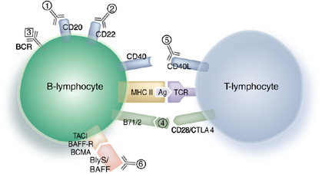
T cell Targets
Abatacept (also called CTLA4-Ig):
inhibition of co-stimulation
prevents CD28 from binding to its counter-receptor, CD80/CD86, due to its higher affinity for CD28
Trials in SLE currently underway

Slide 43
Elevated IL-10 production by monocytes and B-cells could be demonstrated in SLE. IL-10 is involved in B-cell proliferation and anti-IL10 therapy delays the onset of autoimmunity in murine lupus. Monoclonal anti-IL-10 antibodies have been given to six patients with SLE leading to a rapid improvement of arthritis, skin manifestations, and constitutional symptoms

Slide 44
Interferon-α Stimulation
Ronneblom L, Alm GV Arth Res Ther 2003;68-75

Slide 45
Anti-Interferon Alpha (IFNα)
1. Sifalimumab
2. Rontalizumab
3. Anifrolumab
Mechanism of Action
Sifalimumab and rontalizumab are anti-IFNα monoclonal antibodies. An increase in BAFF occurs via signalling of INFα.
In SLE pathogenesis there is activation of type 1 IFN, which is associated with lupus nephritis.
Neutralisation of IFNα will lead to a reduction of inflammation by a reduction in BAFF levels, mature B cells, antibody production and T cell
activation

Slide 46
C5a, a potent neutrophil and monocyte chemotactic factor, is generated by enzymatic cleavage of complement component C5.
Eculizumab, a humanized antibody that blocks C5 cleavage and thereby prevents the generation of the proinflammatory complement components C5a and C5b-9
Phase 1 and 2 in SLE

Slide 48
Thank you

